Slide 1
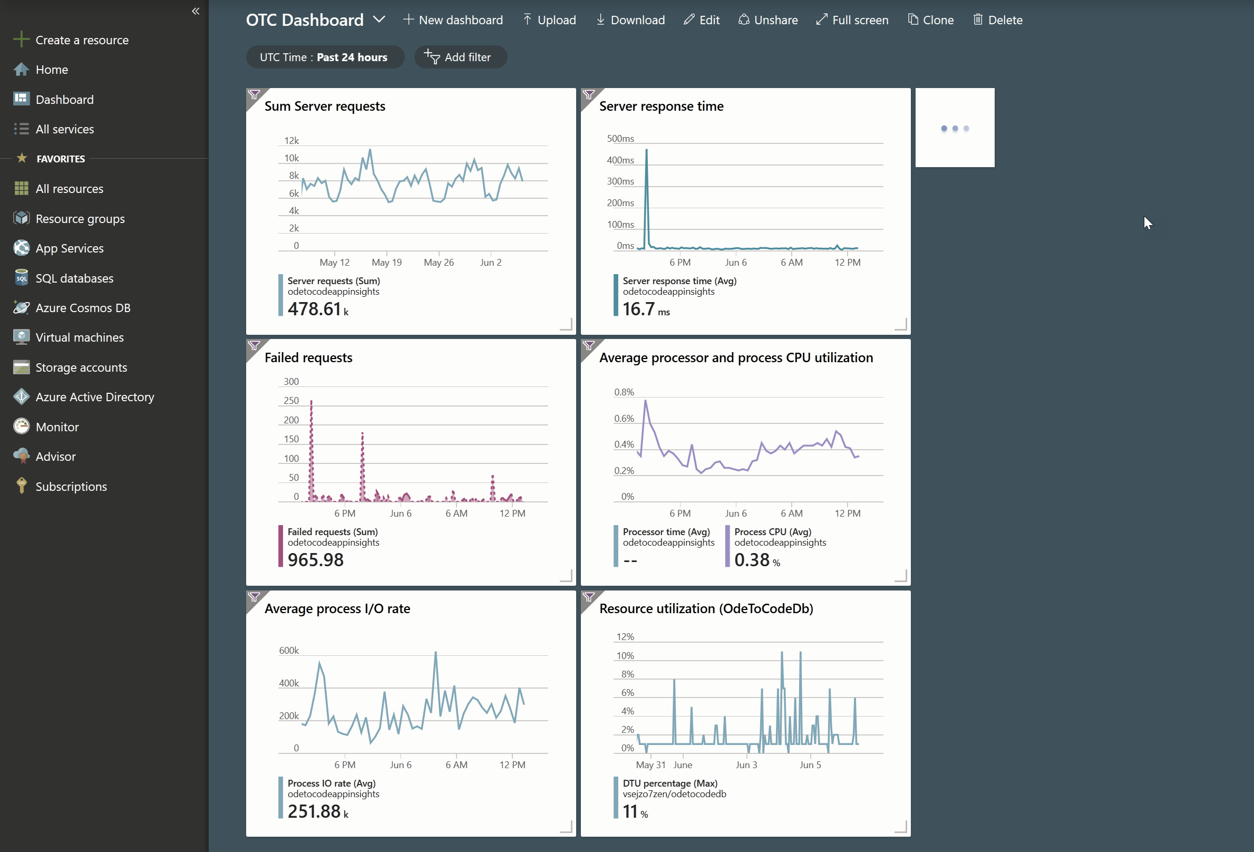

Advanced Azure App Services
K. Scott Allen
@OdeToCode

Slide 2

If you talk HTTP/S, App Services can be your host

Slide 3


App Services is a platform
IaaS
PaaS
SaaS

Slide 4
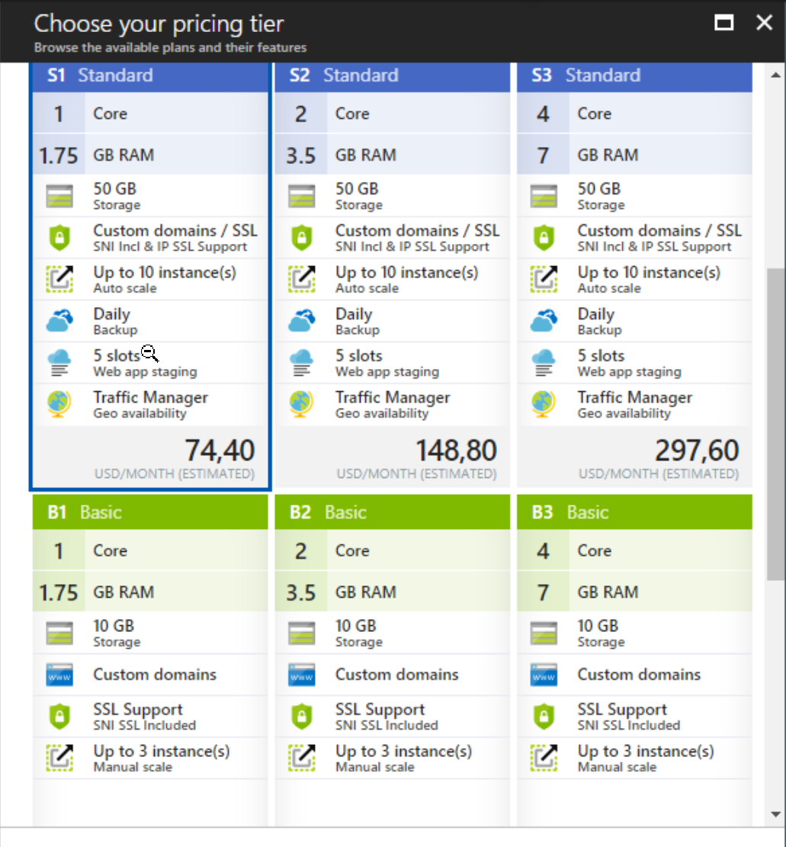
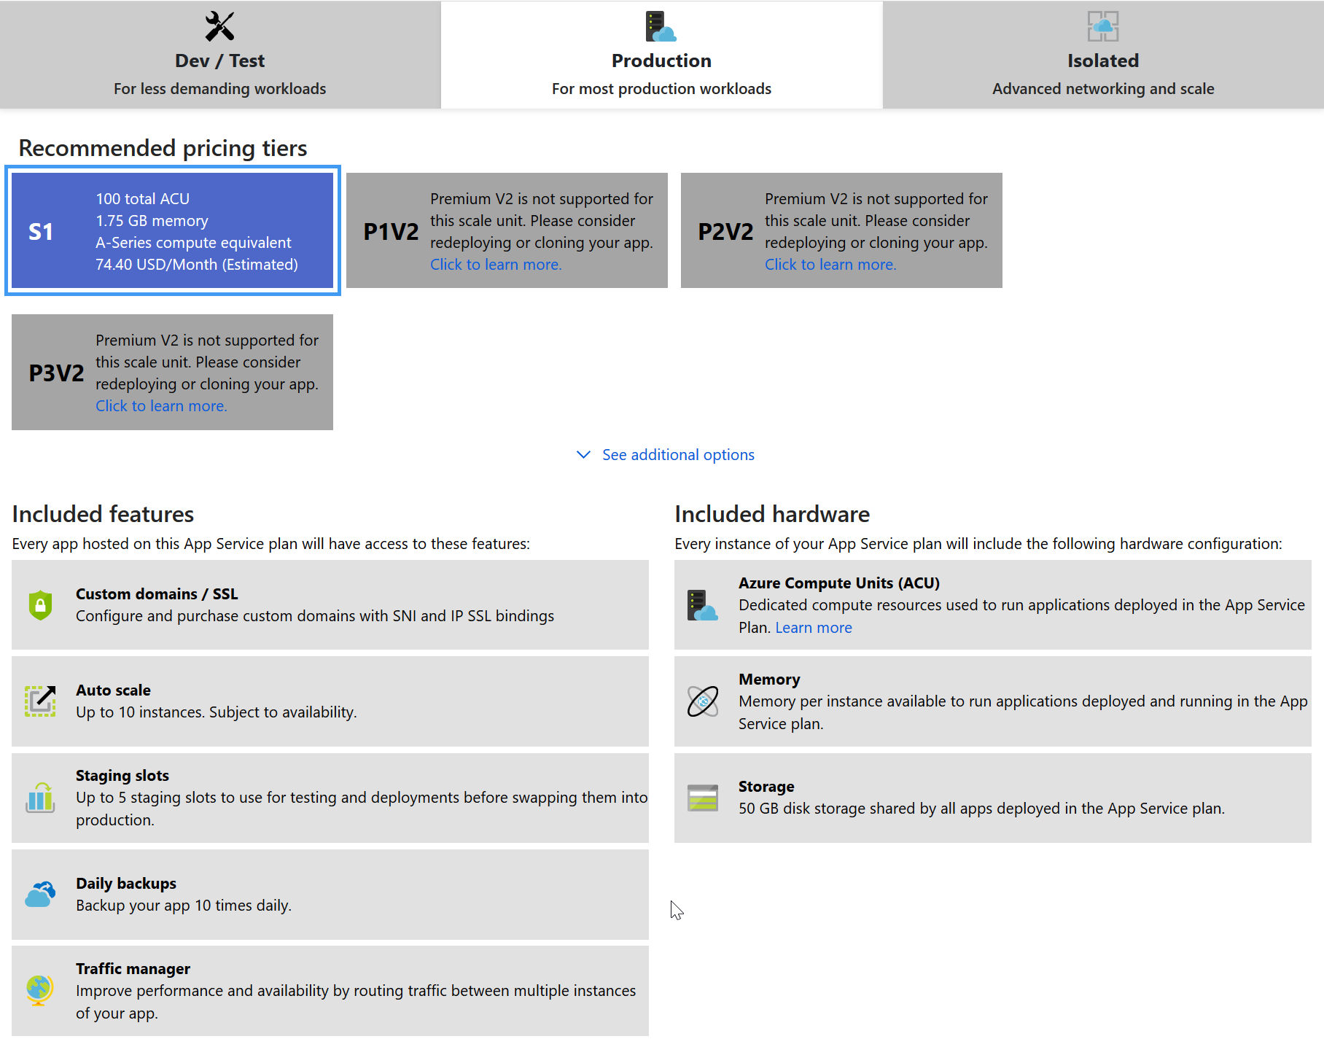
App Services is an abstraction
Old Price Cards
New Price Cards

Slide 5
App Services is an abstraction
SKUs

Slide 6
Agenda
Physical characteristics
Logical architecture
Performance
Diagnostics

Slide 7

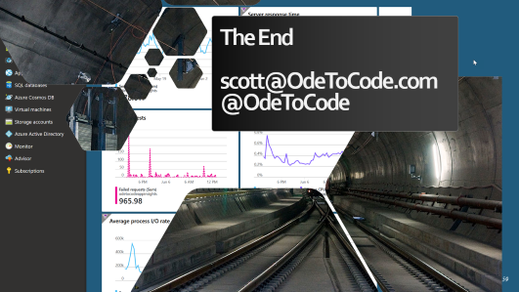
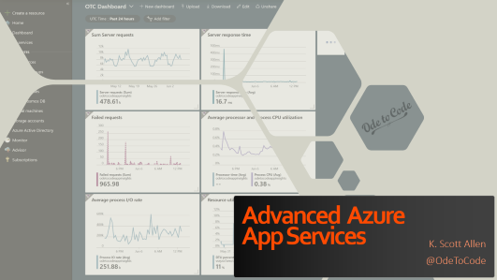
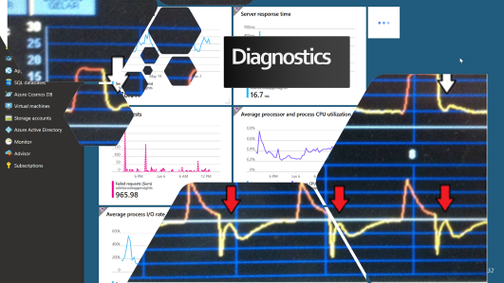
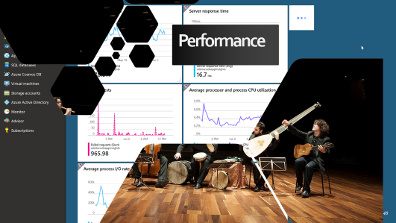
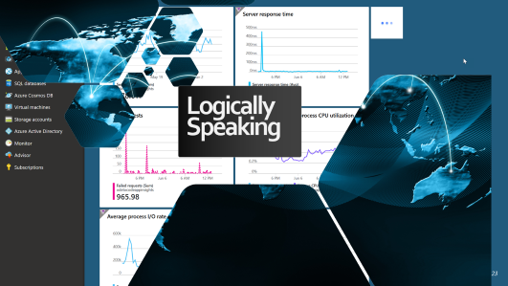

Slide 8
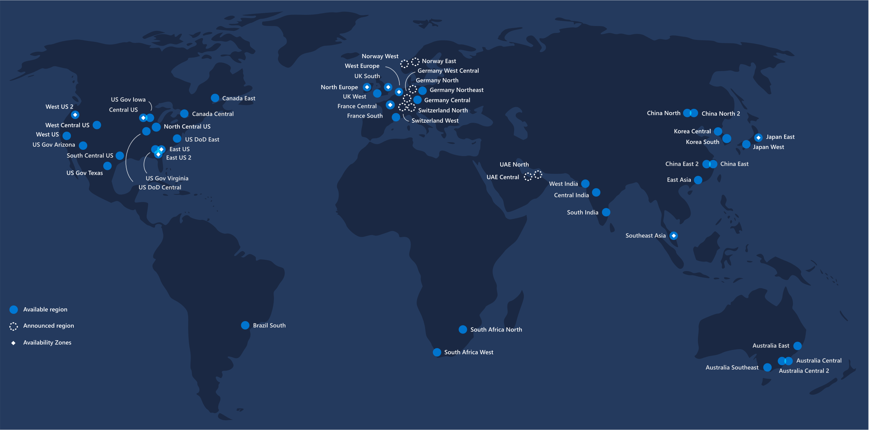
Behind the Physical Curtain

Slide 9
Physically speaking

Slide 10
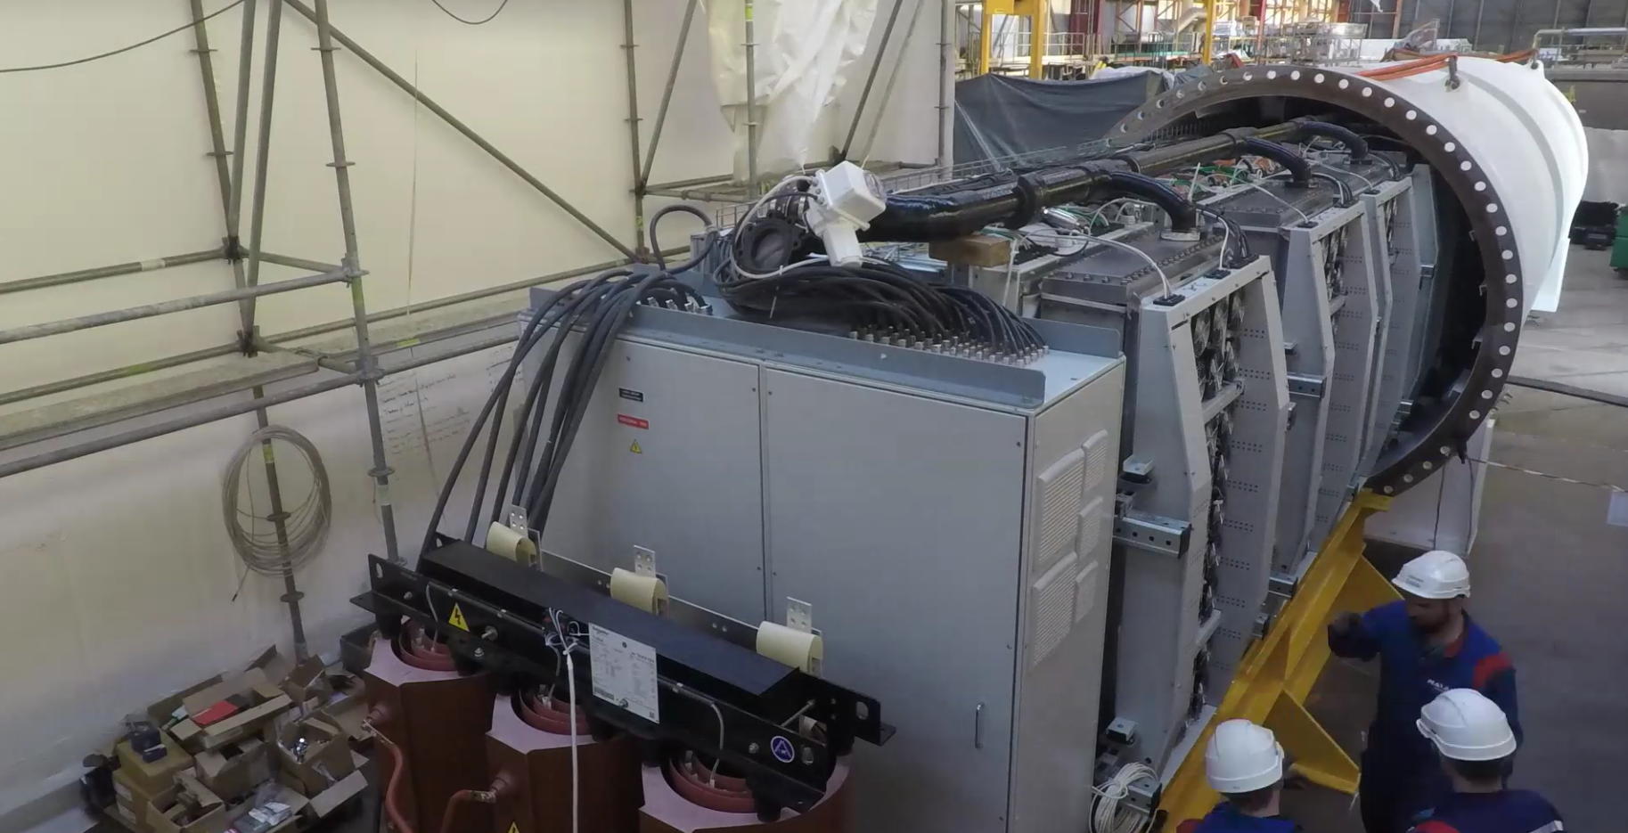
Project Natick

Slide 11
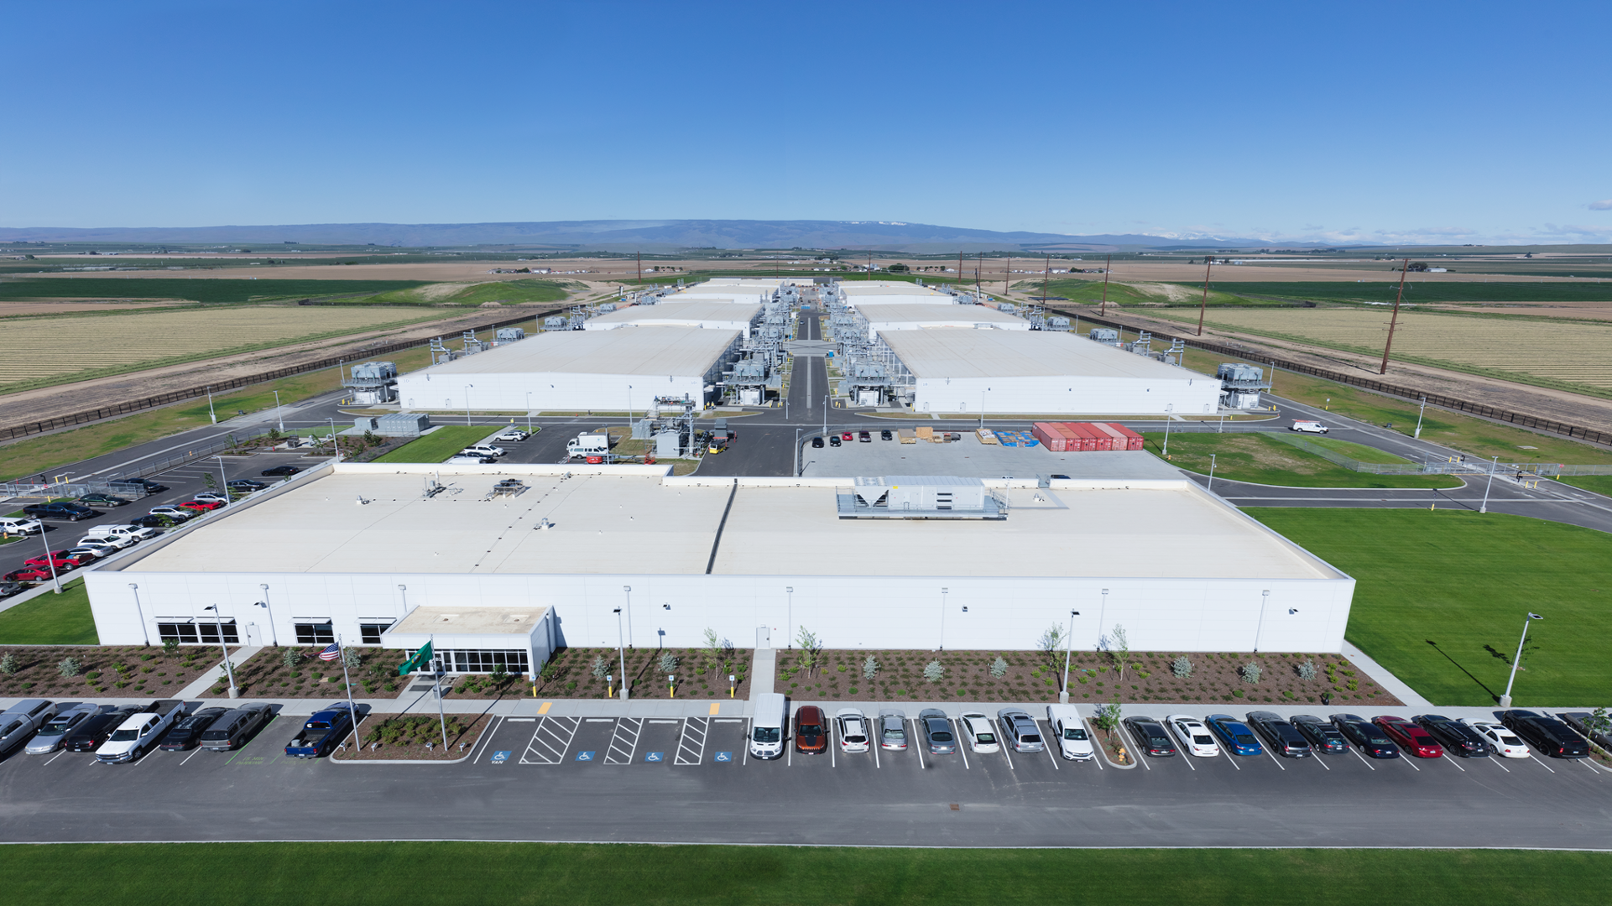
Quincy, WA

Slide 12
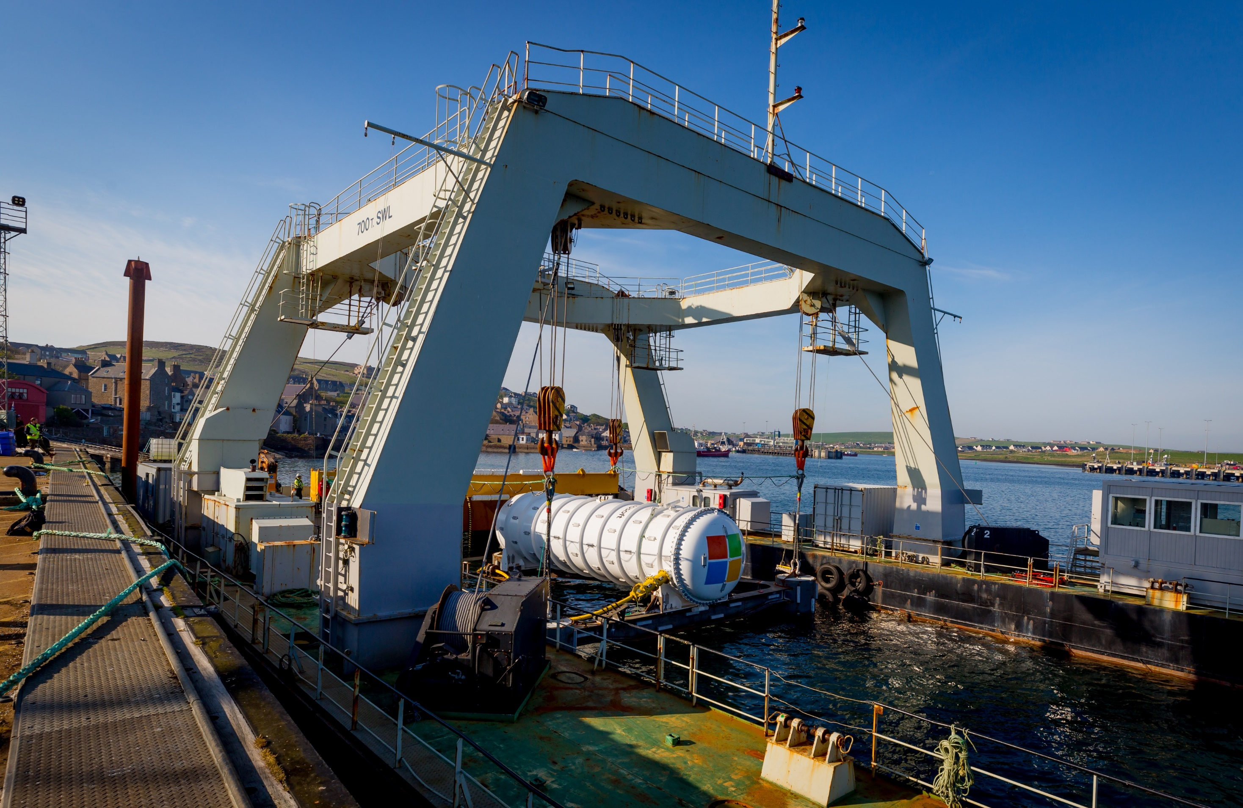

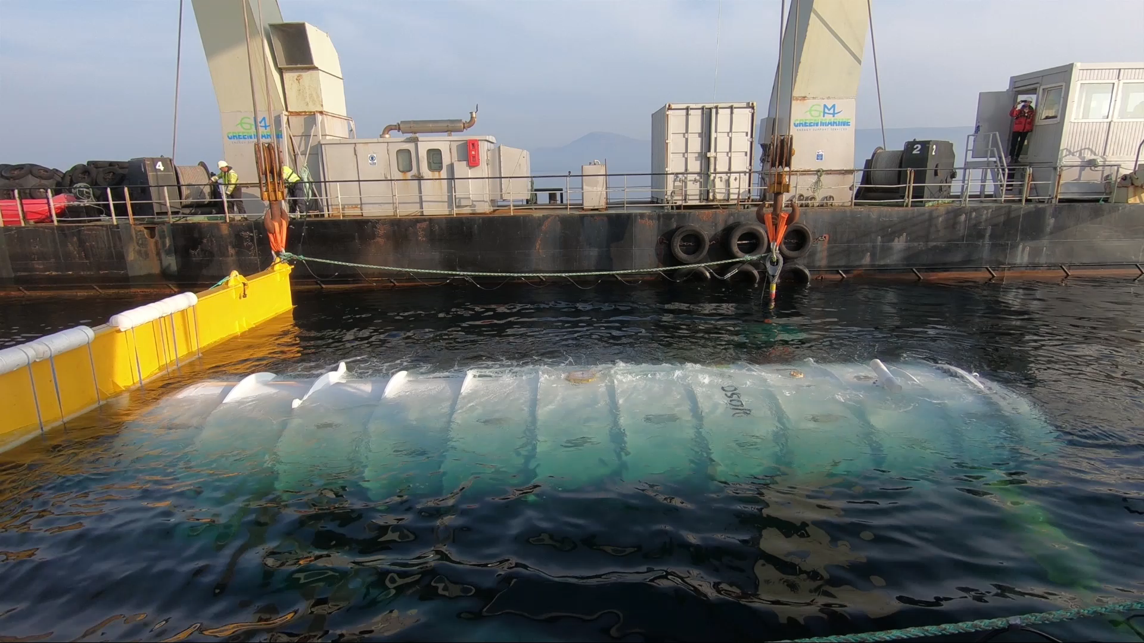


Slide 13

Cheyenne, WY

Slide 14
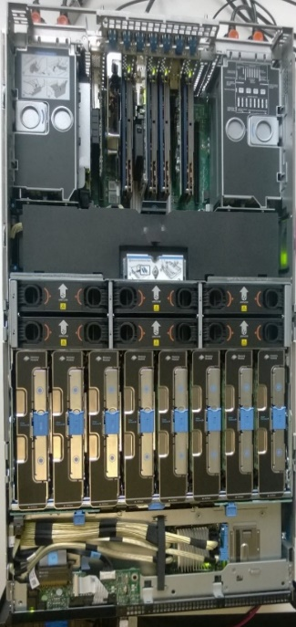
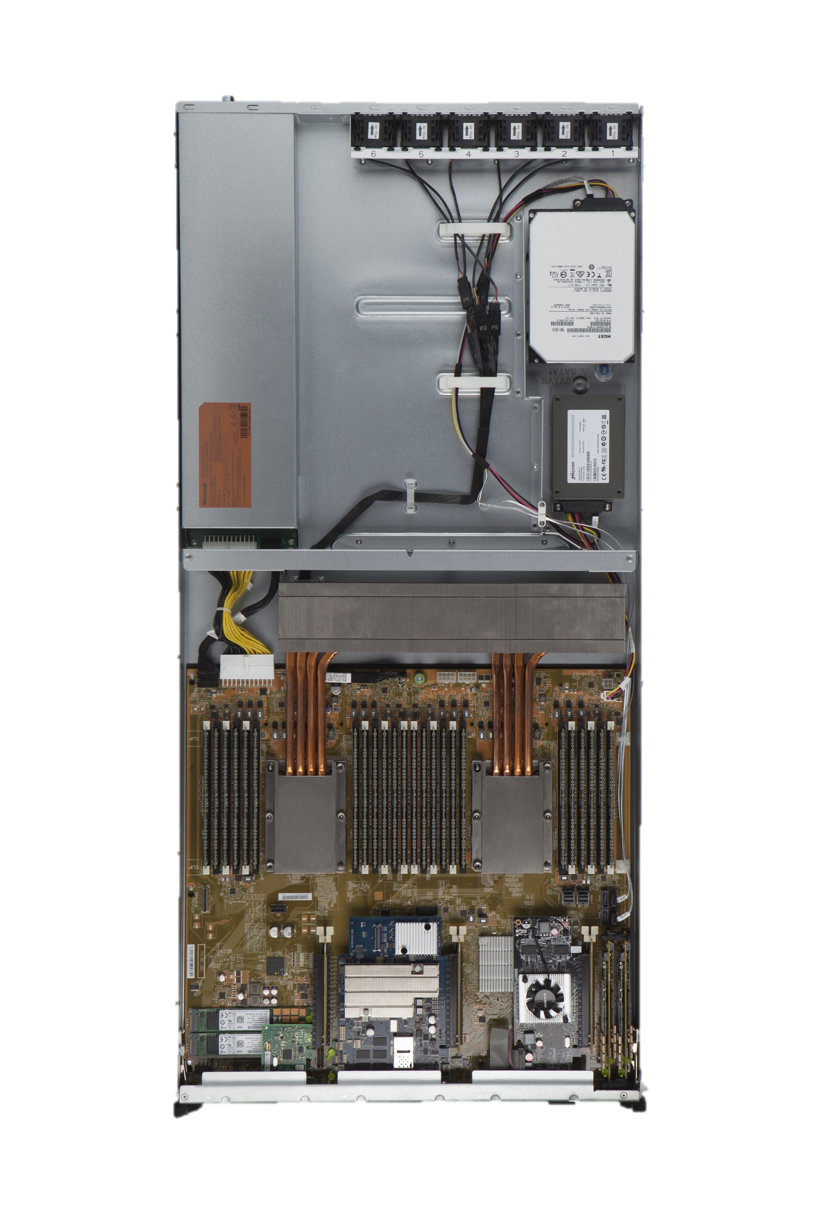
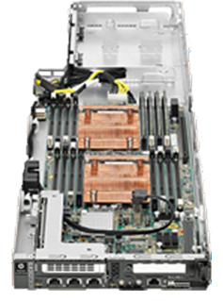
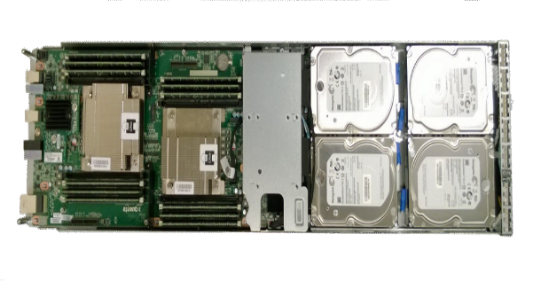
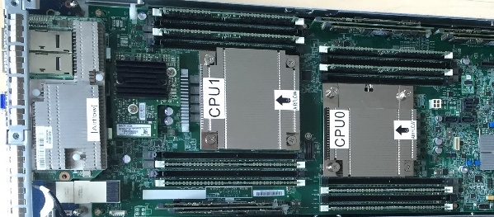
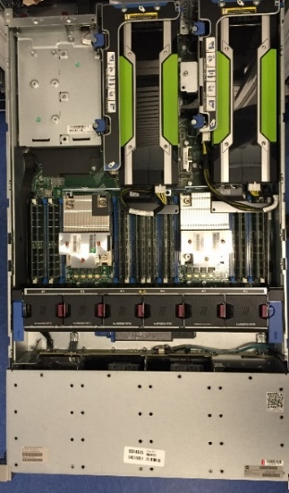
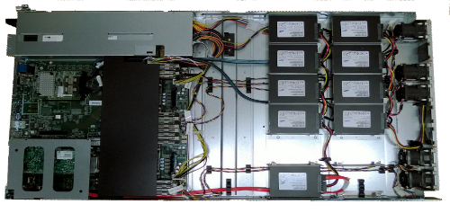
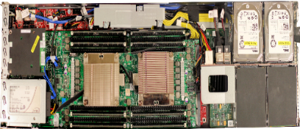
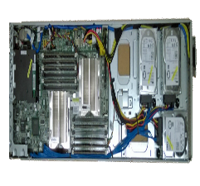
Azure server generations
RAM
Cores
Gen 2
Processor | 2 x 6 Core 2.1 GHz
Memory | 32 GiB
Hard Drive | 6 x 500 GB
SSD | None
NIC | 1 Gb/s
Gen 3
Processor | 2 x 8 Core 2.1 GHz
Memory | 128 GiB
Hard Drive | 1 x 4 TB
SSD | 5 x 480 GB
NIC | 10 Gb/s
HPC
Processor | 2 x 12 Core 2.4 GHz
Memory | 128 GiB
Hard Drive | 5 x 1 TB
SSD | None
NIC | 10 Gb/s IP, 40 Gb/s IB
Gen 4
Processor | 2 x 12 Core 2.4 GHz
Memory | 192 GiB
Hard Drive | 4 x 2 TB
SSD | 4 x 480 GB
NIC | 40 Gb/s
Godzilla
Processor | 2 x 16 Core 2.0 GHz
Memory | 512 GiB
Hard Drive | None
SSD | 9 x 800 GB
NIC | 40 Gb/s
Gen 5.1
Processor | 2 x 20 Core 2.3 GHz
Memory | 256 GiB
Hard Drive | None
SSD | 6 x 960 GB PCIe Flash and 1 x 960 GB SATA
NIC | 40 Gb/s + FPGA
GPU Gen 5
Processor | 2 x 8 Core 2.6 GHz
Memory | 256 GiB
Hard Drive | 1 x 2 TB
SSD | 1 x 960 GB SATA
NIC | 40 Gb/s
GPU | 2 x 2 Compute GPU
Beast
Processor | 4 x 18 Core 2.5 GHz
Memory | 4096 GiB
Hard Drive | None
SSD | 4 x 1920 GB NVMe and 1 x 960 GB SATA
NIC | 40 Gb/s
Gen 6
Processor | 2 x Skylake 24 Core 2.7GHz
Memory | 192GiB DDR4
Hard Drive | None
SSD | 4 x 9600 GB M.2 SSDs and 1 x 960 GB SATA
NIC | 40 Gb/s
FPGA | Yes

Slide 15
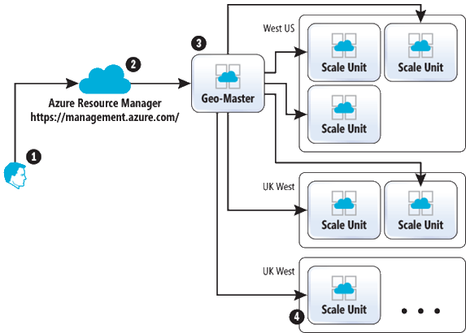
Scale units
https://msdn.microsoft.com/en-us/magazine/mt793270.aspx

Slide 16
Scale units - a.k.a stamps
Front end load balancer
Management (SQL, Data, Publishers)
Your App Services
My App Services
Web Worker Pool

Slide 17
Scale units - a.k.a stamps
Front end load balancer
Management (SQL, Data, Publishers)
Your App Services
My App Services
Web Worker Pool

Slide 18
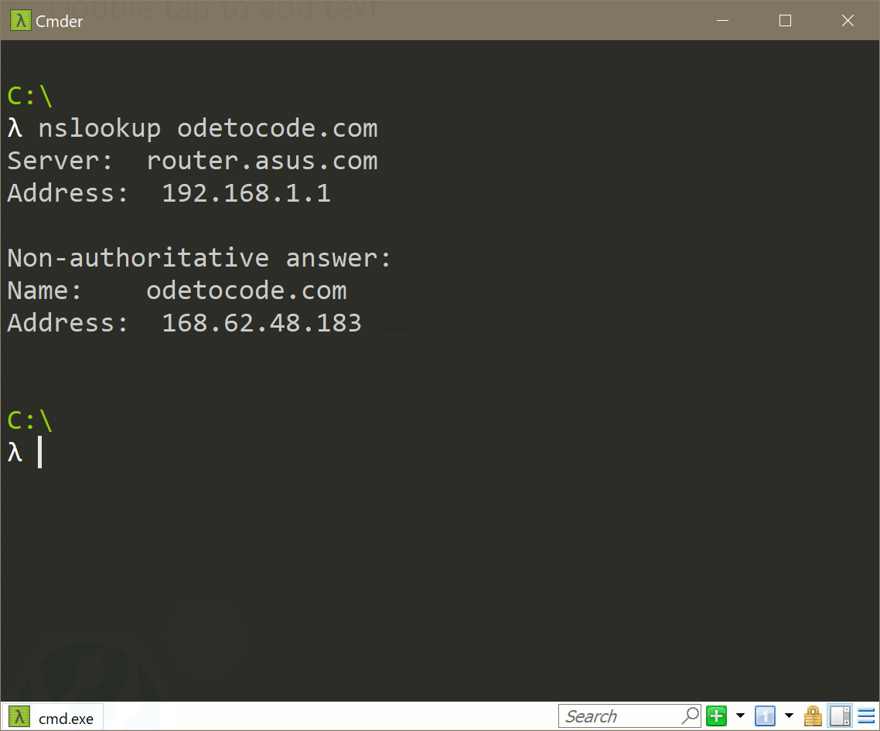
Which stamp?

Slide 19
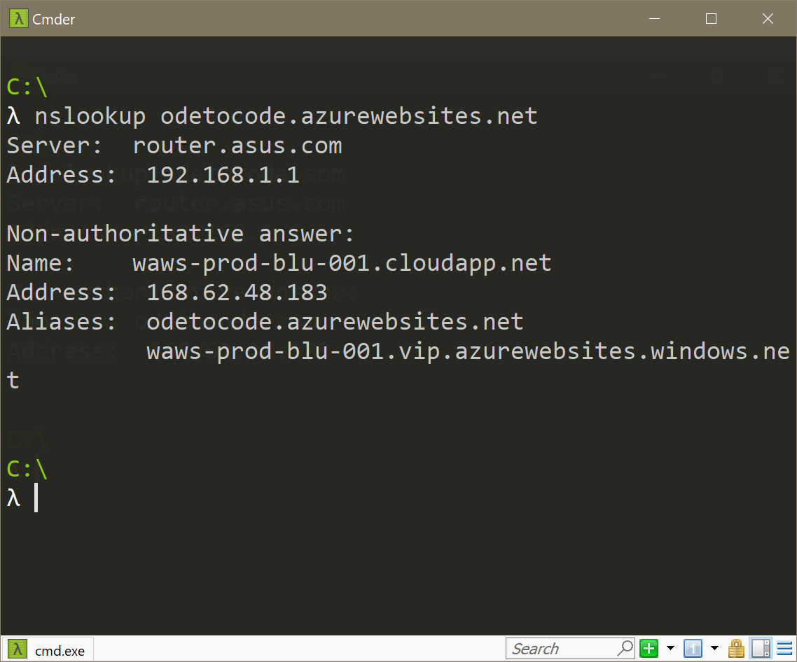
Which stamp?

Slide 20
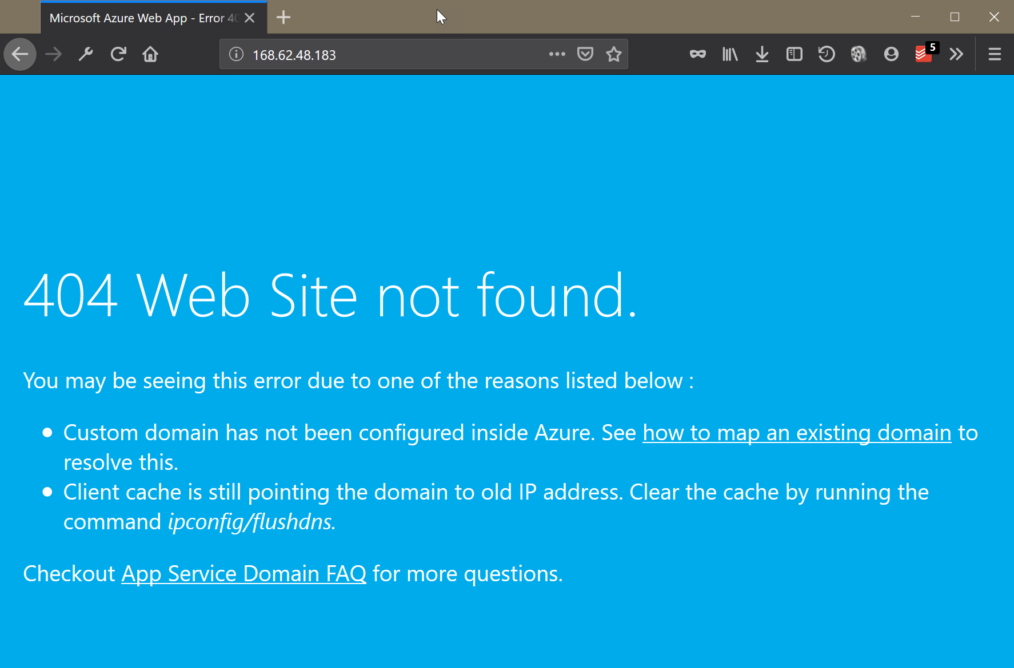
Which stamp?

Slide 21
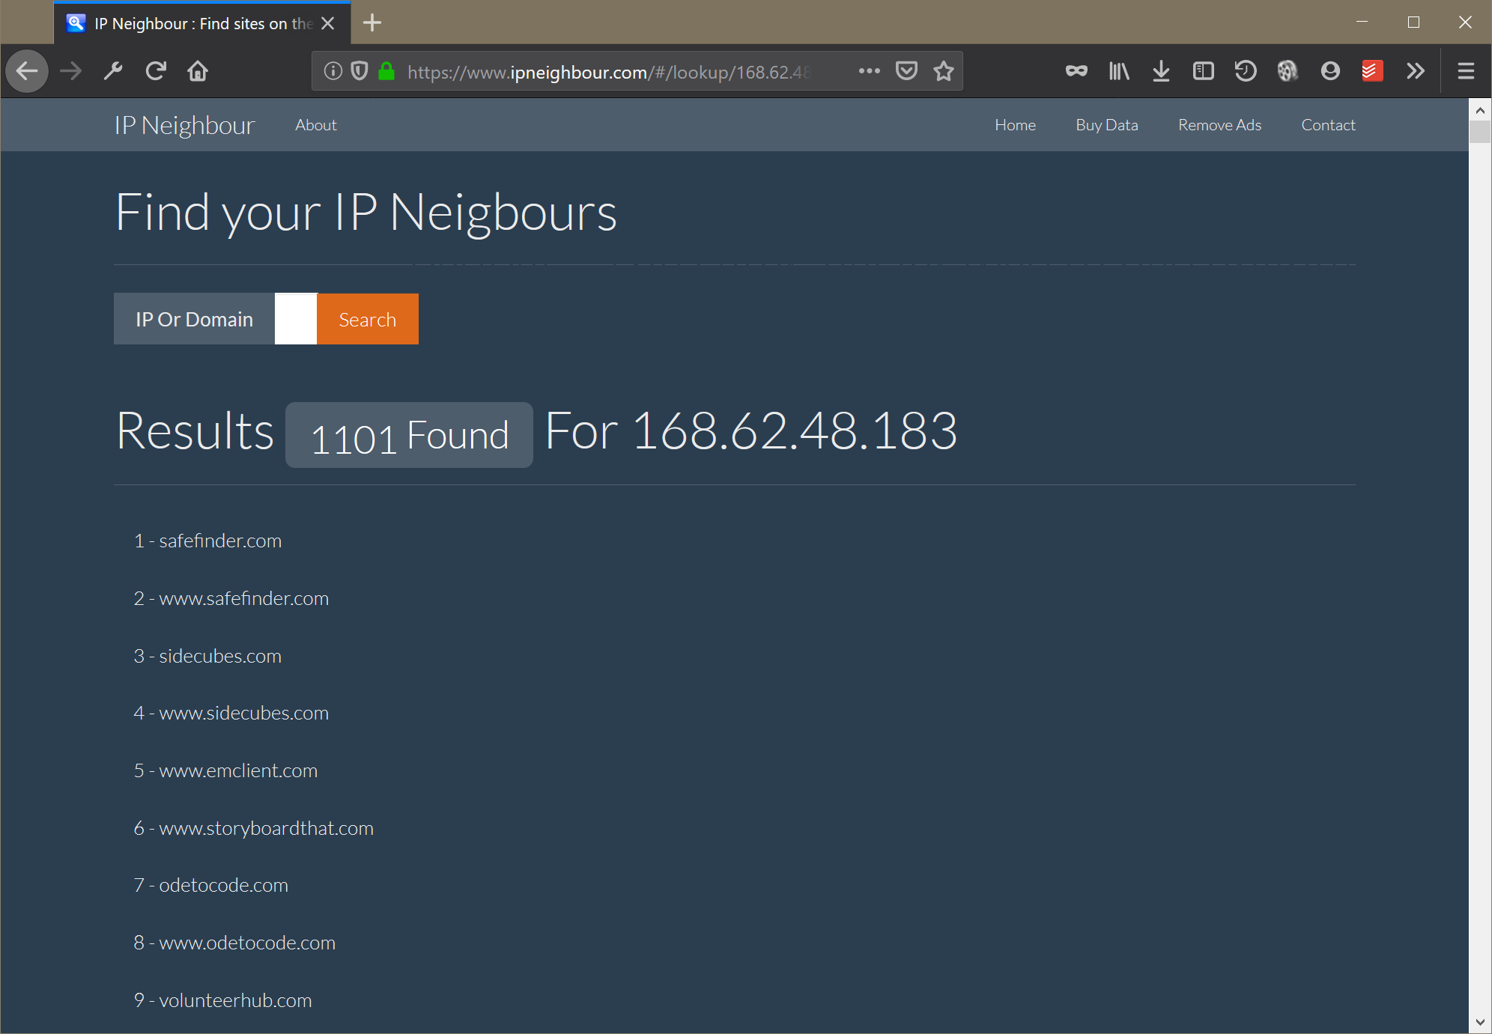





Slide 23

Logically Speaking
This Photo by Unknown Author is licensed under CC BY-SA

Slide 24
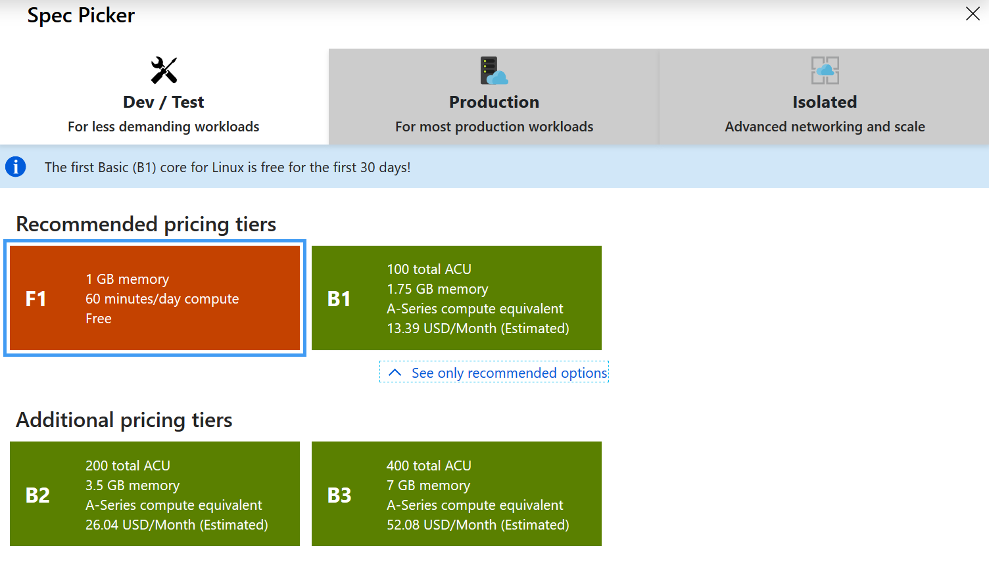
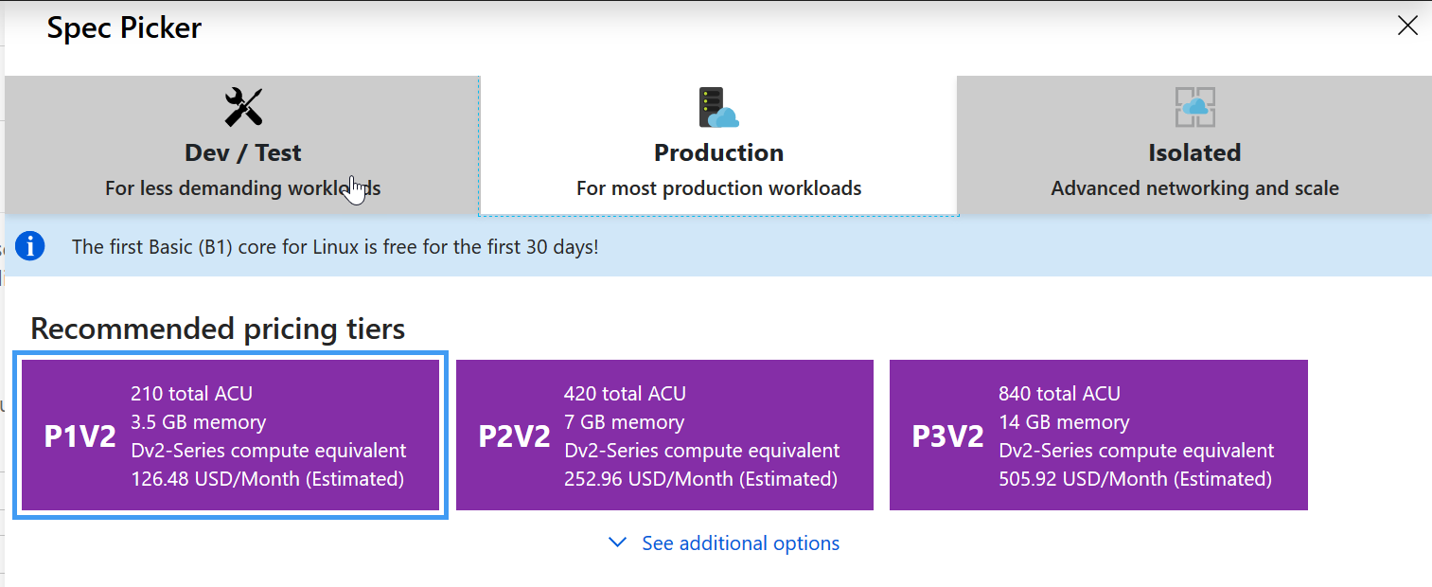
App Service Plan == VM

Slide 25
App Service Plan == VM

Slide 26

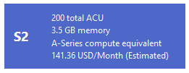
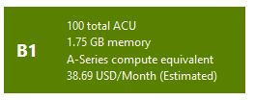


Slide 28
Three apps on one plan
Three apps on two plans

Slide 29
Control your density!

Slide 30
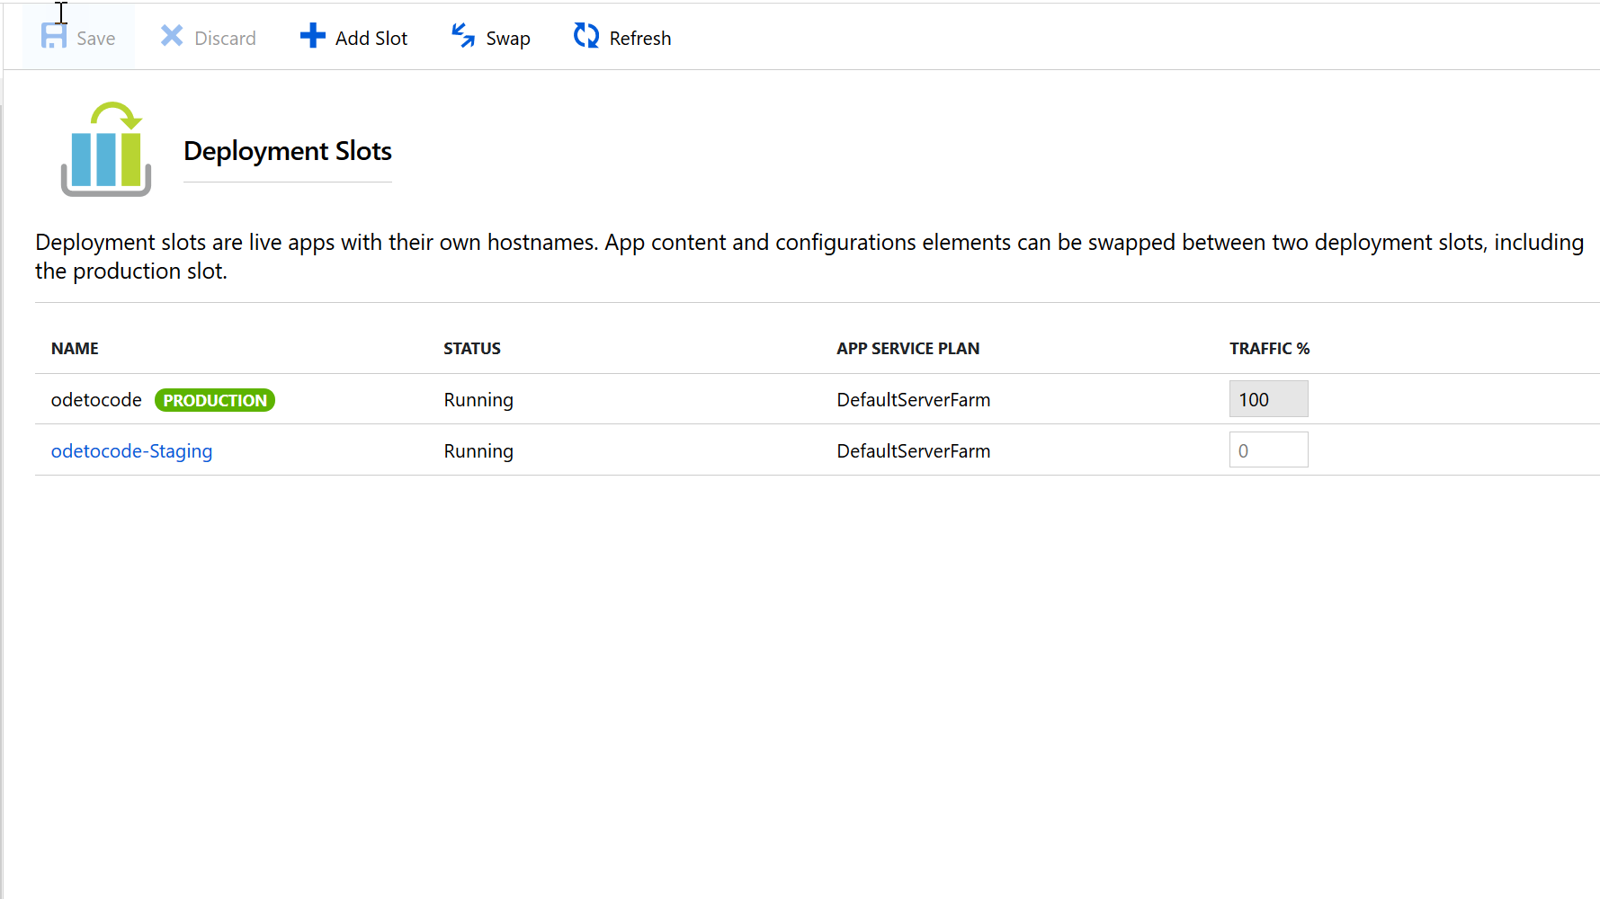

Slide 31
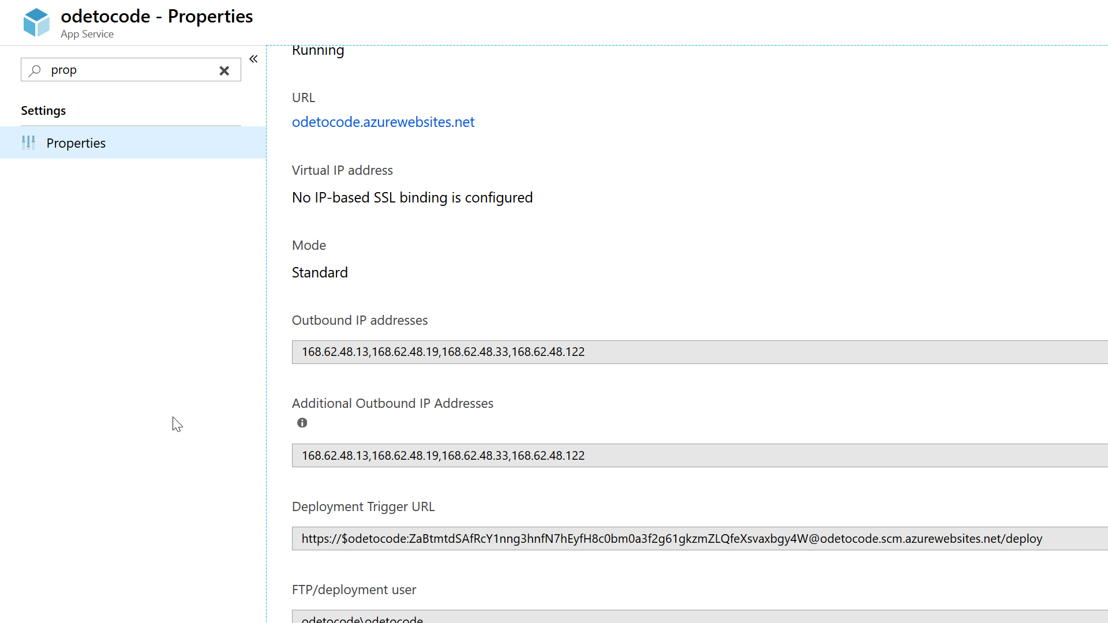

Slide 32
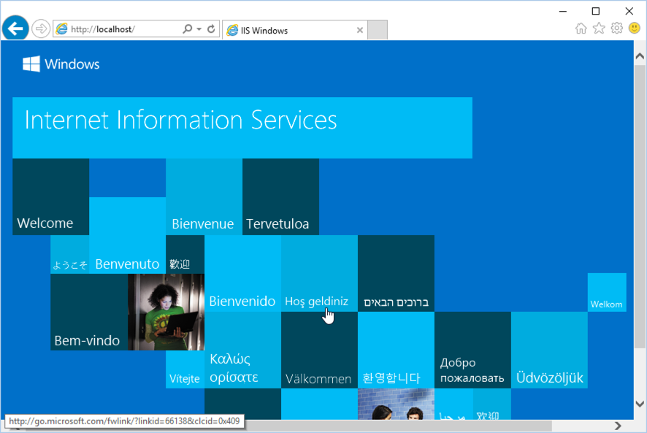
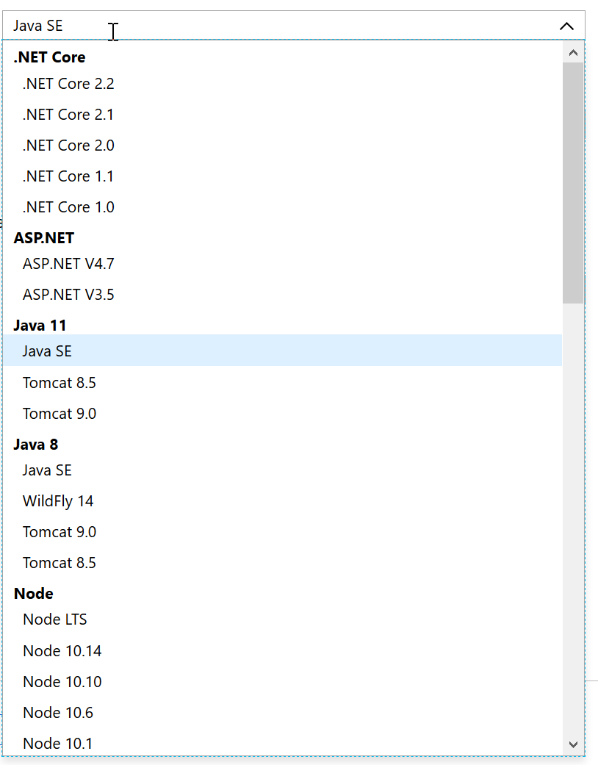
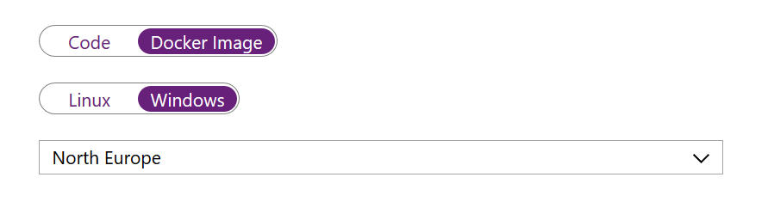
What’s In the VM?
Windows App Service
Linux App Service
Container App Service

Slide 33
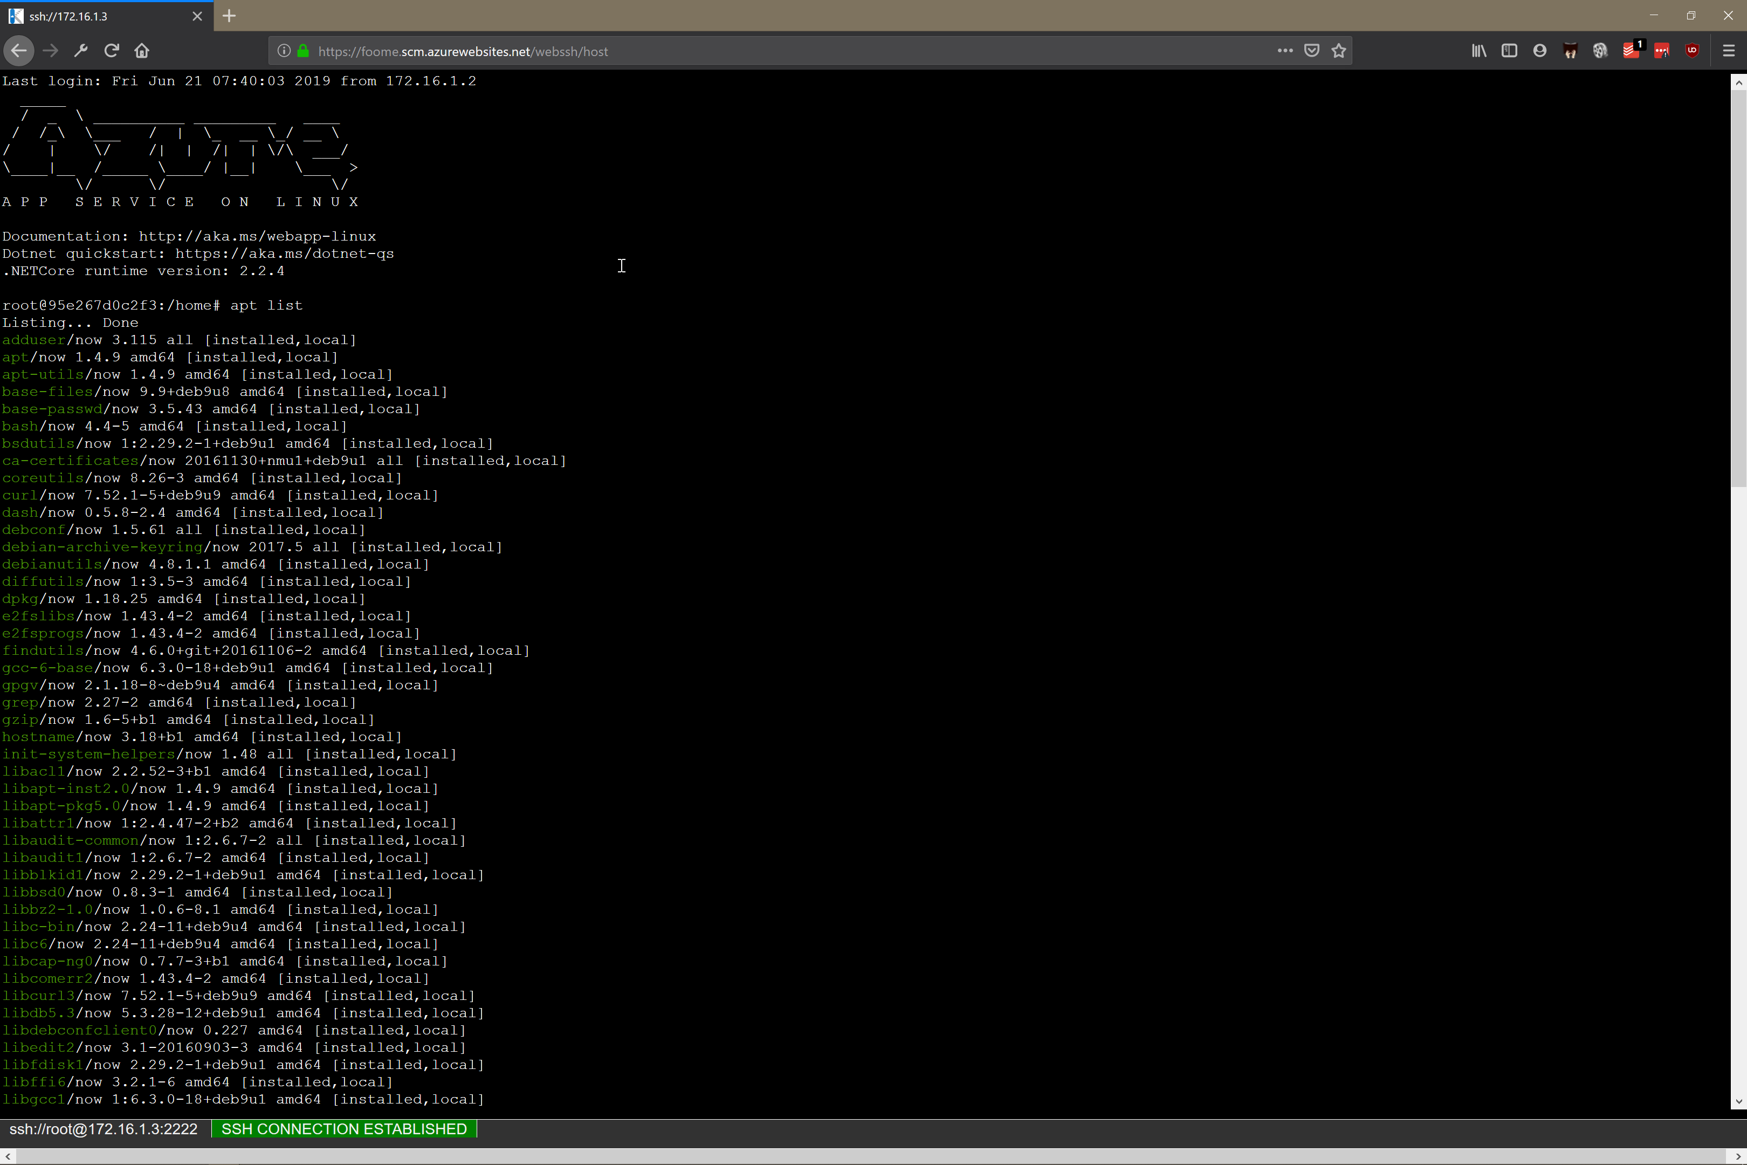
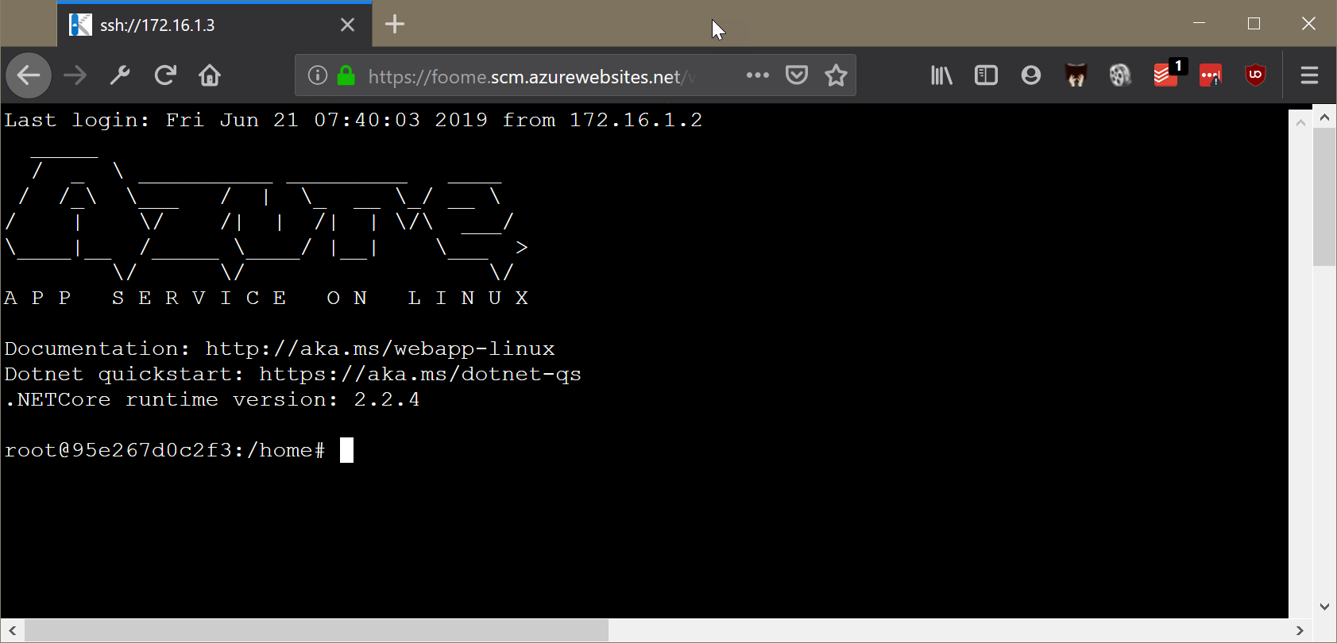
Getting Into the VM

Slide 34
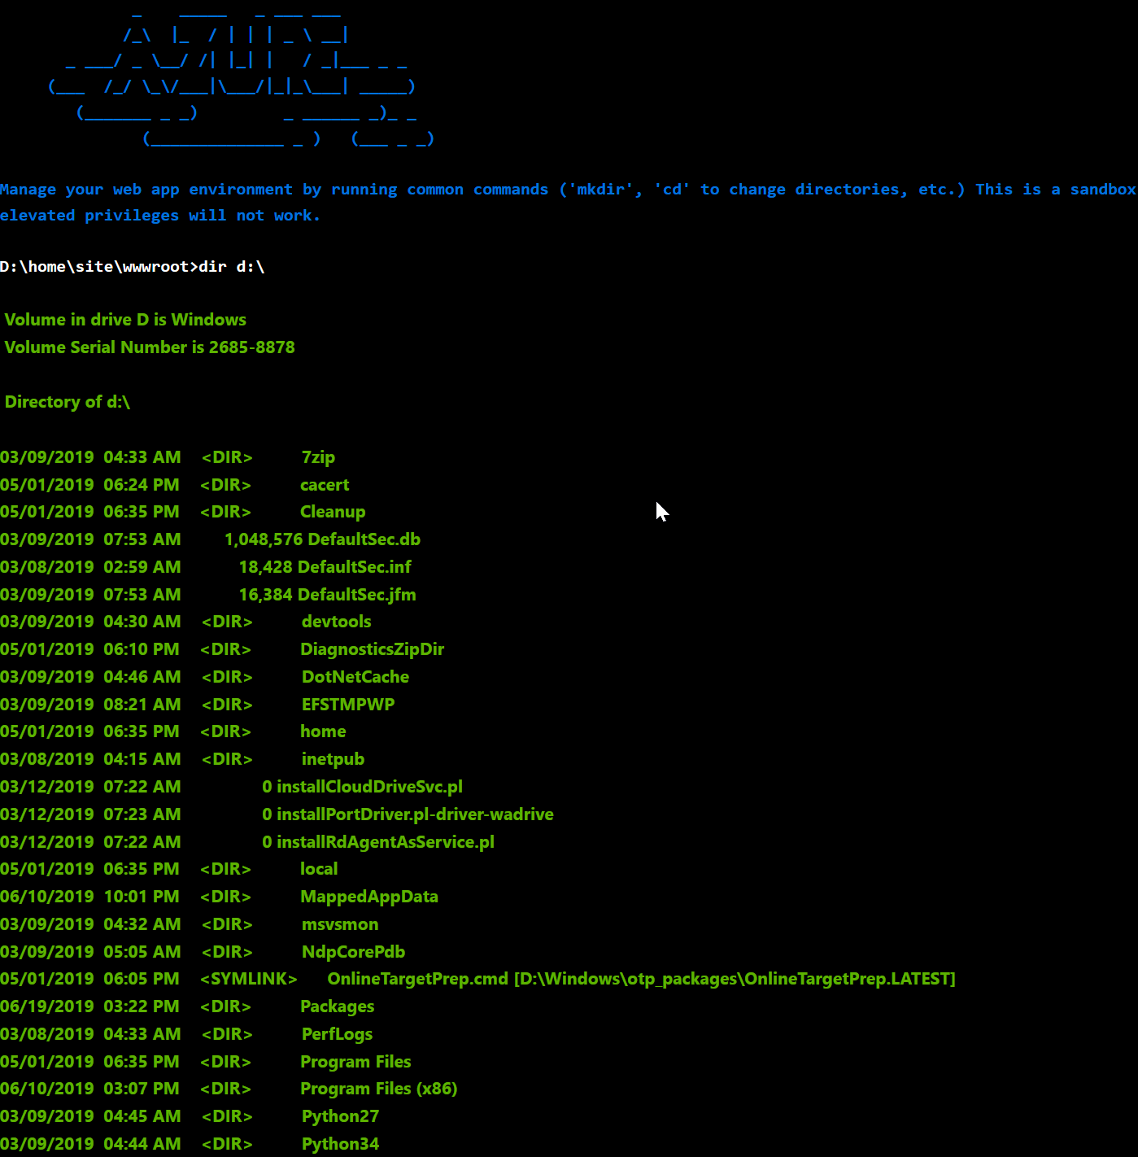
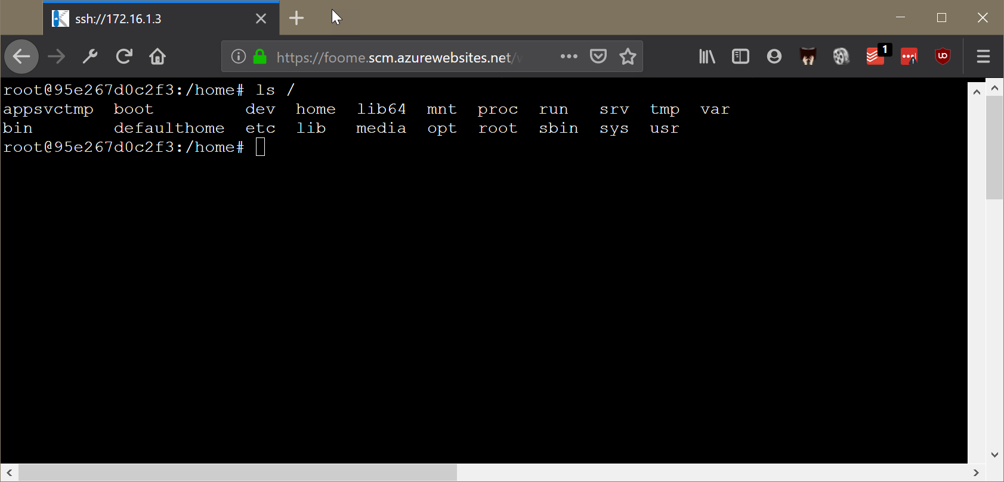
The File System

Slide 35

The File System
Persisted files live in %HOME%

Slide 36
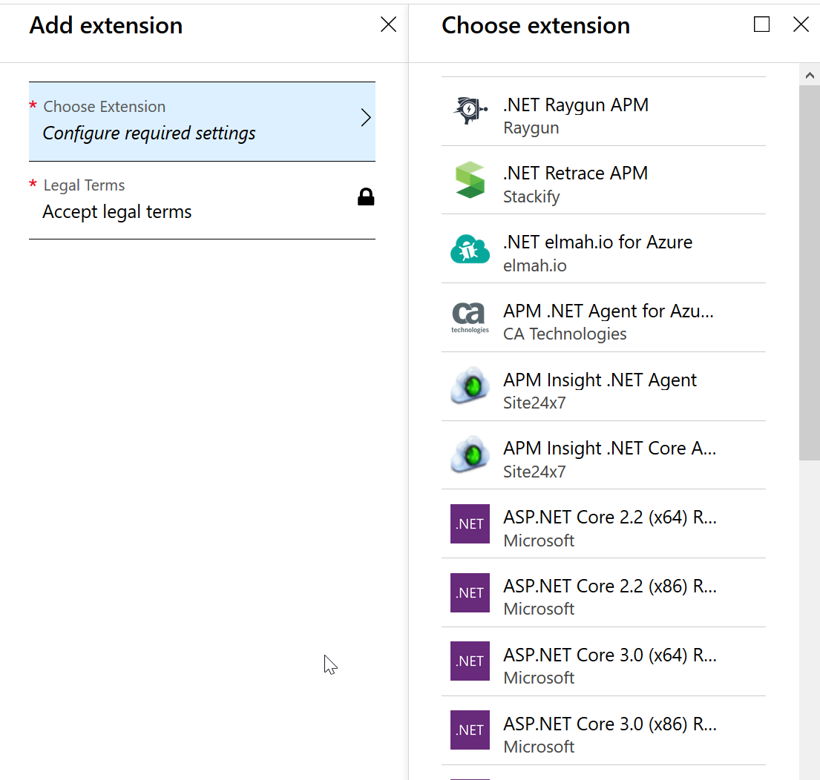
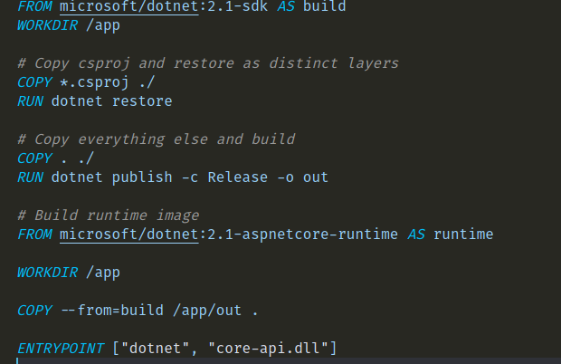
Customizing the Environment

Slide 37
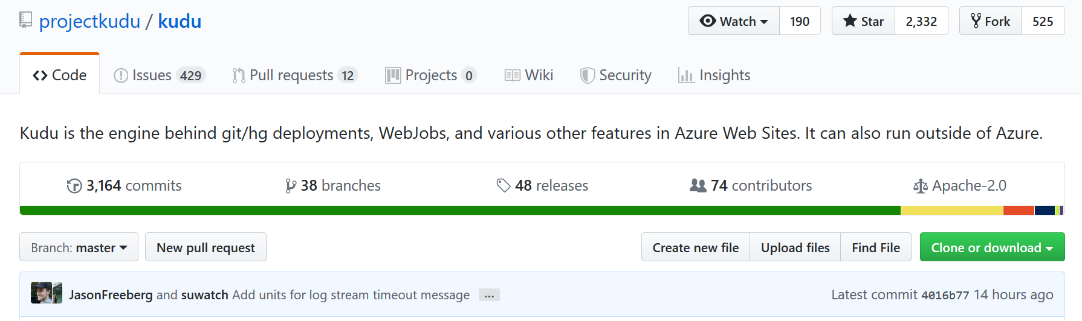
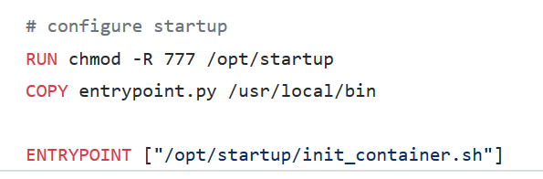
Deployment
Windows App Service
Local Git
Remote Git
FTP / FTPS / WebDeploy
Azure DevOps
Linux App Service
Local Git
Remote Git
FTP / FTPS
Azure DevOps
Container App Service
Any container registry

Slide 38
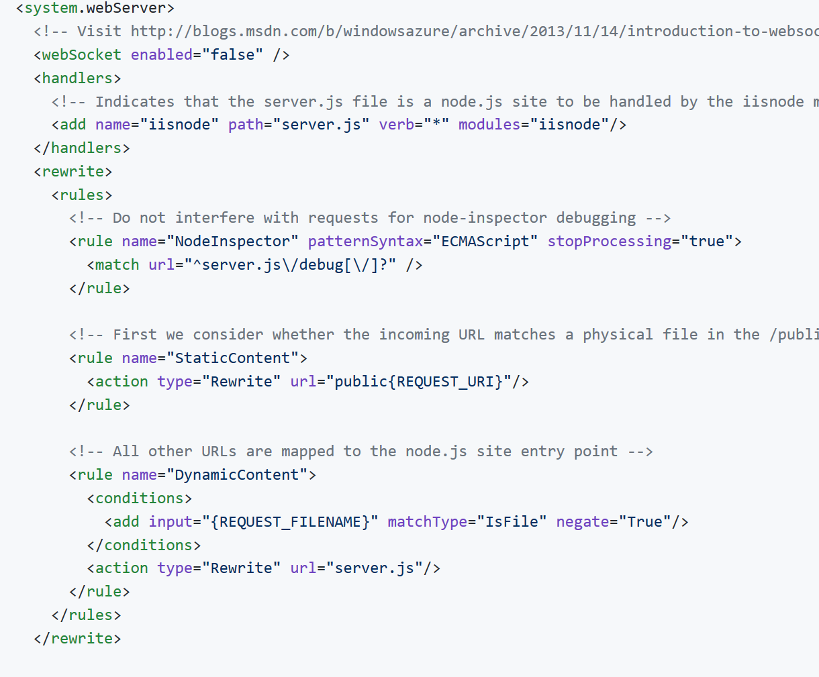

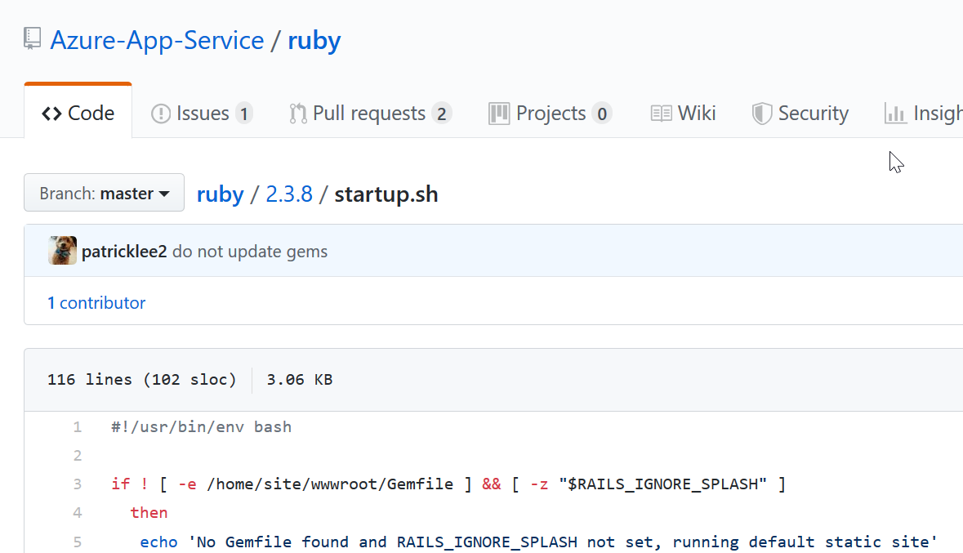
Custom App Launch
Windows App Service
Use web.config
Linux App Service
Many heuristics used
Is there a package.json?
Is there a gemfile?
Is there an application.py?
Set custom startup command
Container App Service
Do anything!
Set WEBSITES_PORT
Set WEBSITES_WEB_CONTAINER_NAME

Slide 40

Performance
This Photo by Unknown Author is licensed under CC BY-SA

Slide 41
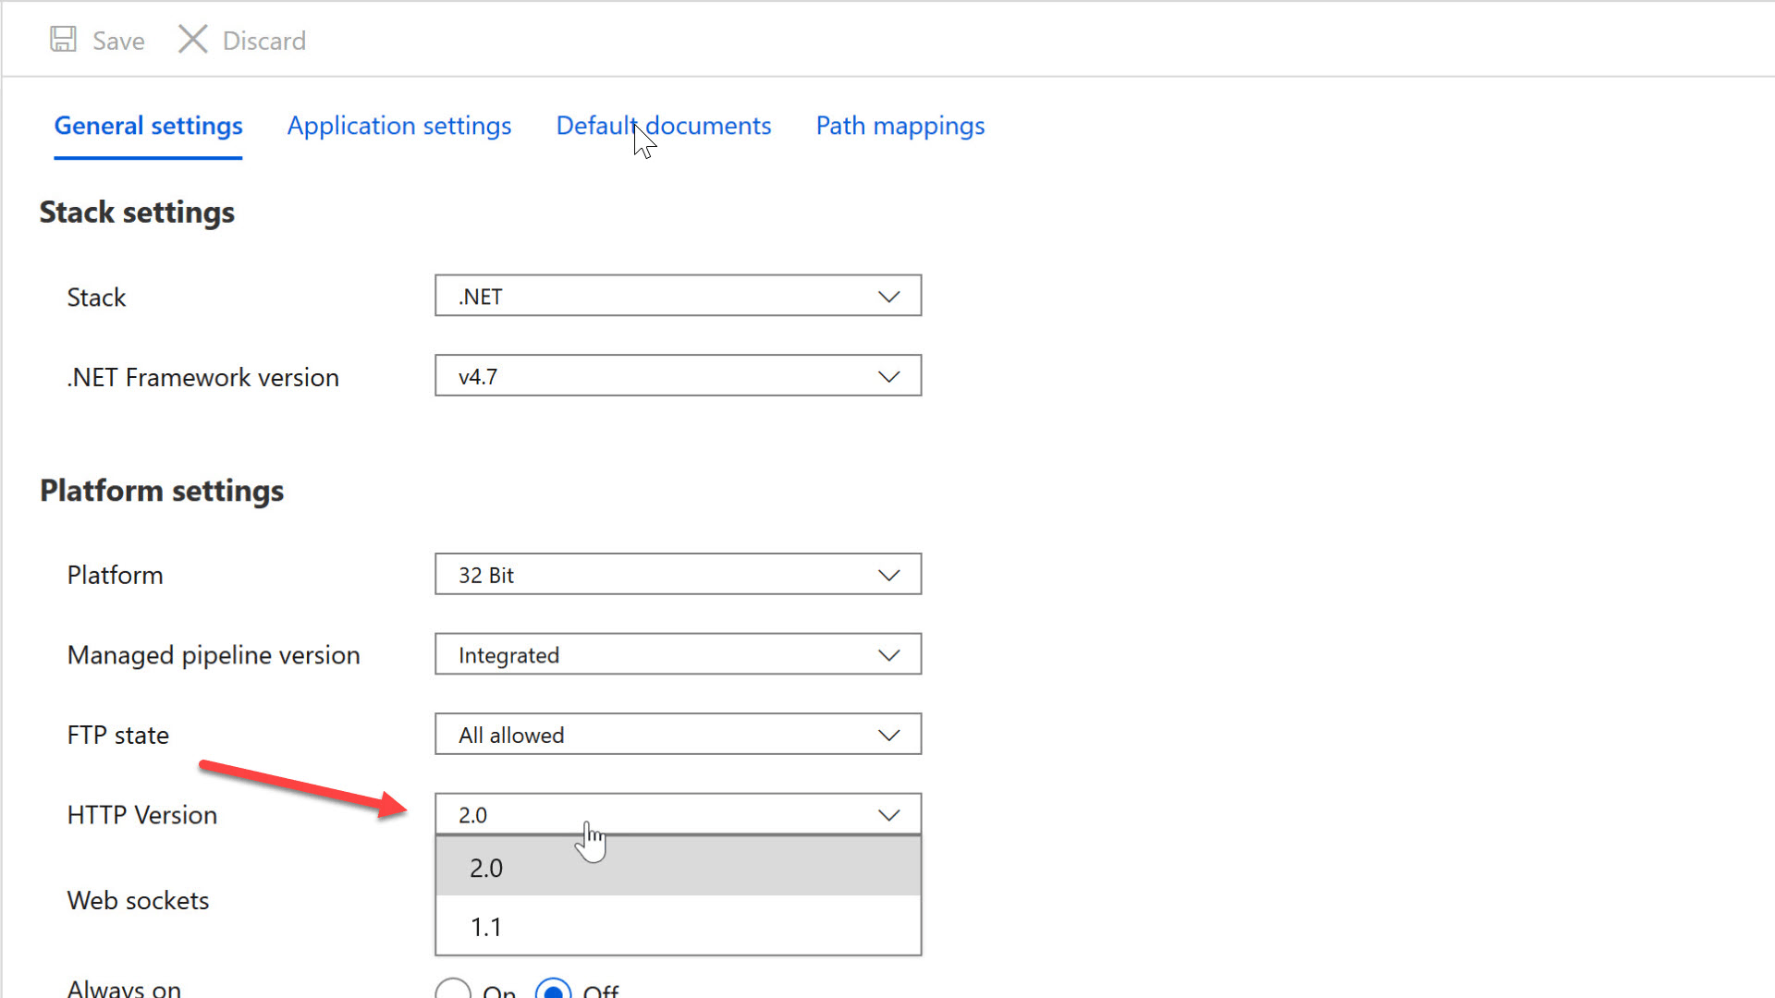
Performance Tips
Enable HTTP/2

Slide 42
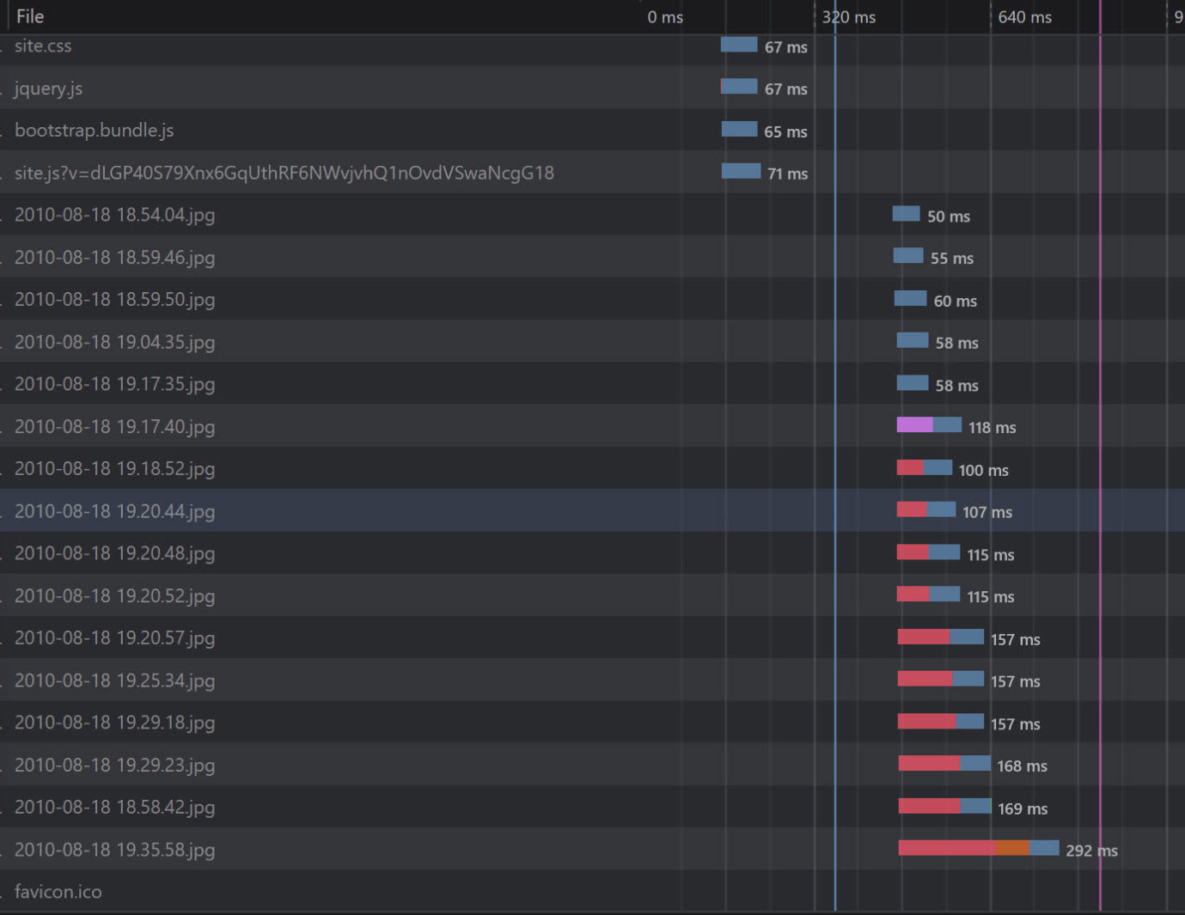
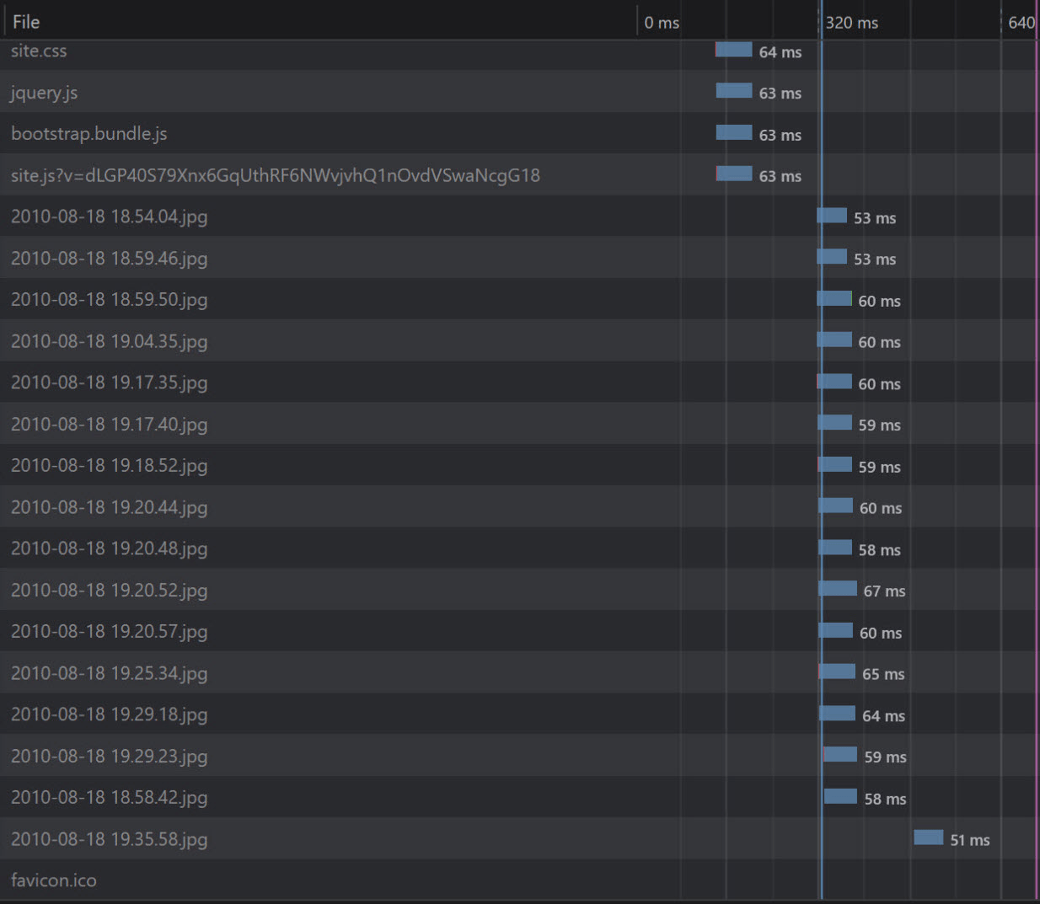
Performance Tips
Enable HTTP/2

Slide 43
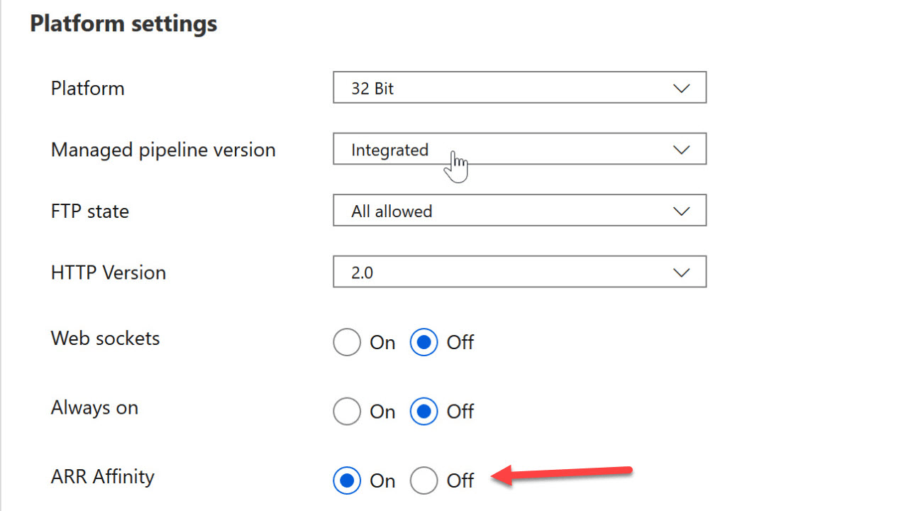
Performance Tips
Turn off Application Request Routing

Slide 44
Performance Tips
Turn off Application Request Routing

Slide 45

Performance Tips
Keep the App Service Always On

Slide 46

Performance Tips
Keep dependencies close

Slide 47

Performance Tips
Keep assets close to customers

Slide 48

Performance Tips
Keep App Service close to customers with Traffic Manager

Slide 49

Performance Tips
Keep App Service close to customers with Front Door

Slide 50
Front Door versus Traffic Manager
Traffic Manager
Front Door Service
DNS Based
Cheap
Easy
Does health monitoring
Different routing methods
Latency
Geographical
Weighted
Slow to failover
A Proxy
Uses IP Anycast
Instant failovers
Intelligent caching
Dynamic site acceleration
Network optimizations

Slide 52

Diagnostics
This Photo by Unknown Author is licensed under CC BY

Slide 53


Diagnostics

Slide 54

Diagnostics

Slide 55

Diagnostics

Slide 56

Diagnostics

Slide 57

Diagnostics

Slide 59

The End scott@OdeToCode.com @OdeToCode
This Photo by Unknown Author is licensed under CC BY-SA

